Slide 1
BT201
Biochemical Process Calculations
08/09/2022

Slide 2
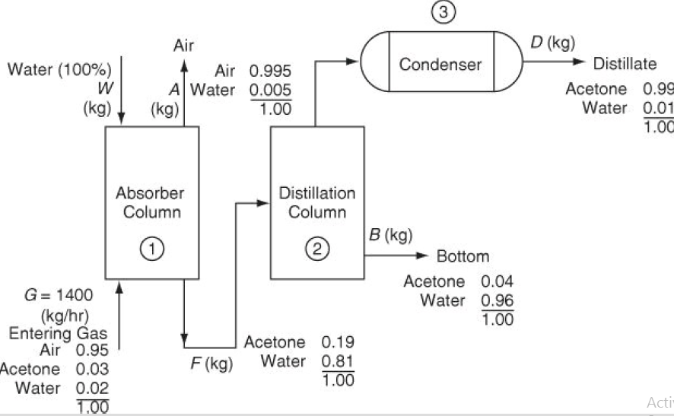
Tutorial: 1
Acetone is used in the manufacture of many products and also as a solvent. In its latter role, many restrictions are placed on the release of acetone vapor to the environment. You are asked to design an acetone recovery system having the flowsheet illustrated in Figure. All of the concentrations shown in Figure of both the gases and liquids are specified in weight percent. Calculate A, F, W, B, and D in kilograms per hour. Assume that G = 1400 kg/hr.

Slide 3
Degrees of freedom with overall balances
Unknowns Variables: W, A, B and D (the FOUR unknown flow streams).
Equations: Four needed to solve for the four unknowns.
Component material balances: three (one for each component: air, water, acetone)
Degrees of freedom: 1

Slide 4
Degrees of freedom
Unit 1 (absorber)
Variables: Eight components whose values are known and are assigned plus three variables whose values are not known (the unknowns): W, F, and A (the three unknown flow streams).
Equations: Three needed to solve for the three unknowns. The basis, G = 1400 kg, has already been assigned a value. What relations are left to use? The component material balances: three (one for each component: air, water, acetone).
Degrees of freedom: Zero. Thus, you can solve for the values of W, F, and A.

Slide 5
Complete lack of information about the properties of the stream going from the distillation column to unit 3 (the condenser). Thus, the substitute system and the degree-of-freedom analysis we select will be for a combined system composed of units 2 and 3.
Units 2 and 3
(distillation column plus condenser)
Variables: F, D and B (three streams) are the only unknowns; the component mass fractions in each stream, 2 × 3 = 6, are known values and have
already been assigned values.
Equations: Two component balances, one for acetone and the other for water.
Degrees of freedom: 1.
But if start with absorber analysis then F will be known, then DOF of unit 2 and 3 will be zero

Slide 6
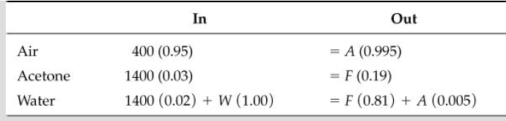
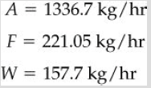
Unit 1 (absorber)

Slide 7


Units 2 and 3
(distillation column plus condenser)

Slide 8
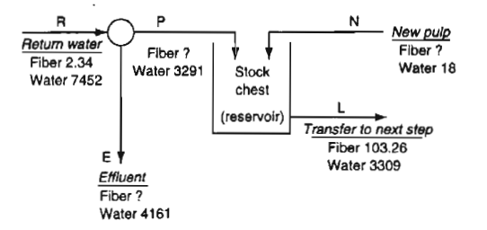
Tutorial: 2
In a tissue paper machine , stream N contains 85% fiber. Find the unknown fiber values in kg each stream. All values in the figure are in kg.

Slide 9
Splitter
Total: R=E+P
Fiber:2.34=F_{E}+F_{P}
STOCK CHEST
Total: P=N+L
Fiber: F_{E} + F_{N}=103.26
STOCK CHEST
Water: N*0.15=18
N=120

Slide 10
Overall
Total: R+N=E+L
Fiber:2.34+0.85*N=F_{E}+103.26
Fiber:2.34+0.85*120=F_{E}+103.26
F_{E} =1.08
STOCK CHEST
F_{E} + F_{N}=103.26
F_{N} =103.26-1.08=102.18
Splitter
Fiber:2.34=F_{E}+F_{P}
F_{P} =2.34-1.08=1.26

Slide 11
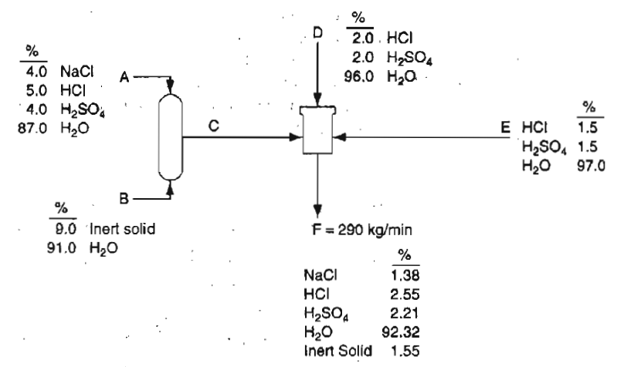
Tutorial: 2
A process is shown in Figure. Given that the output stream F is 290 kg/min. Calculate A, B, C, D, and E in kilograms per min

